Slide 1


Report to V2U
How to better enhance communication effectiveness
By Wirth, Enzo，Richard, Kevin
Photo taken in capital Antananarivo, old Palace/holy City

Slide 2


CONTENT
Part 01
Introduction
Part 02
Wiki & Training
Part 03
Information security
Part 04
Conclusion

Slide 3

01
Introduction
80% of problems in the workplace are communication related.
good communication results in a healthy working climate

Slide 4
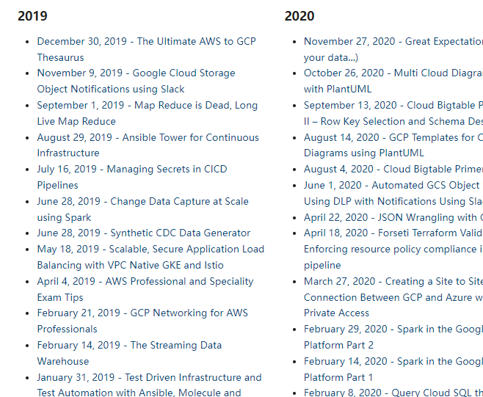
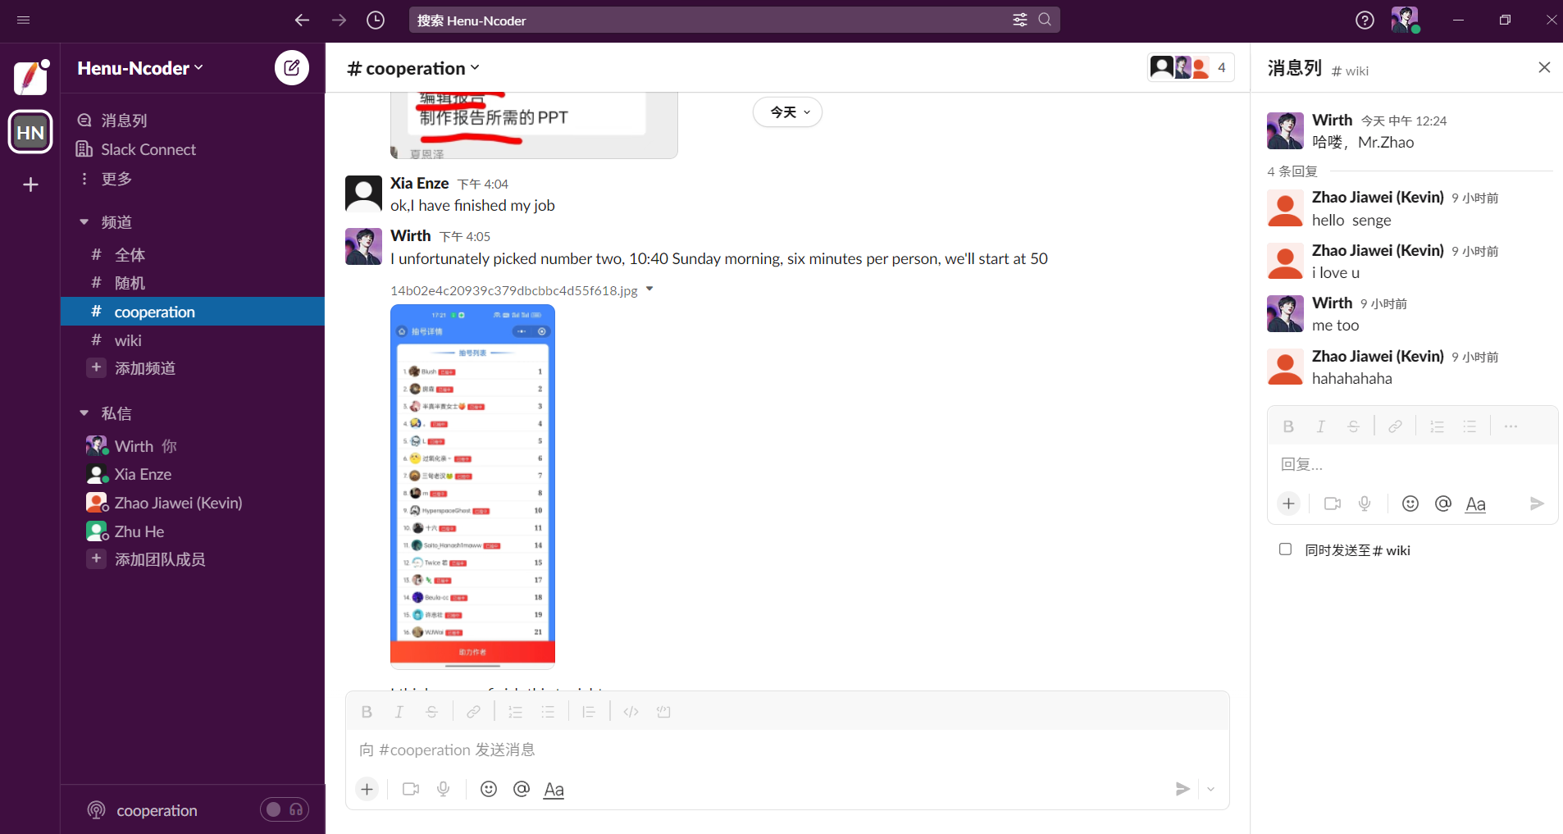
02
Wiki site
Effects
SLACK's team works

Slide 5


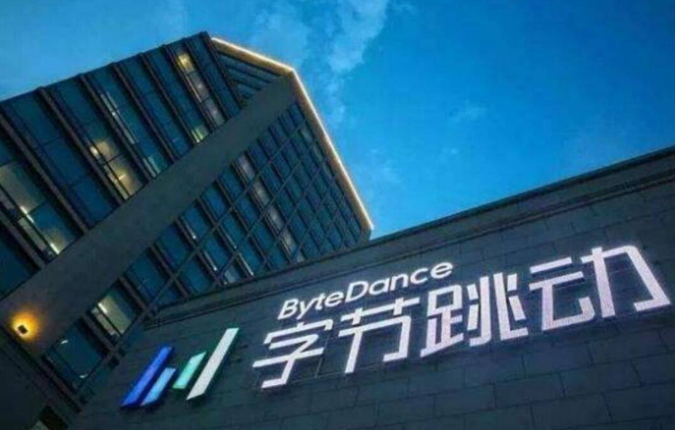
02
Training programs
Pay attention to listening.
Always have a positive attitude.
Take good notes and review later.

Slide 6

03
Information security
Protect password and track your mobile devices.
Protect the organization.
Develop a good psychological profile.
标题文字内容
标题文字内容
ENTER THE TITLE HERE
ENTER THE TITLE HERE

Slide 7


04
Conclusion
Good communication tool WiKi
2. Good training
3. Good information security
PPT模板 http://www.1ppt.com/moban/

Slide 8
Reference list
[1]Science and technology document 2012, Effective Communication in the Workplace, viewed by 11 June 2022,
<https://www.docin.com/p-388072607.html?docfrom=rrela>
[2]Pramila M 2016, Perfecting Workplace Communication Skills - Verbal Communication, viewed 11 June 2022,
<https://www.docin.com/p-1512494930.html?docfrom=rrela>
[3] Alan, P 2009, Wikis in the workplace: a practical introduction, Conde Nast, viewed 13 June 2021,
<https://arstechnica.com/informationtechnology/2009/11/welcome-to-the-wiki-party/>
[4] Doyle A 2021, Types of Listening Skills With Examples , viewed 11 June 2022,
< https://www.thebalancecareers.com/types-of-listening-skills-with-examples-2063759>
[5] Indeed Editorial Team 2022,10 Ways To Have a More Positive Attitude at Work, Indeed Editorial Team,
viewed by 11 June 2022,< https://www.indeed.com/career-advice >
[6] University of Lincoln 2022, TOP 10 Information Security Tips, University of Lincoln, viewed by 11 June
2022, <https://ict.lincoln.ac.uk/infosec/top-10-information-security-tips/>
[7] Weller J 2016, How Workplace Collaboration Can Change Your Company, Smartsheet, viewed by 11 June
2022, <How Workplace Collaboration Can Change Your Company<https://www.smartsheet.com>>

Slide 9

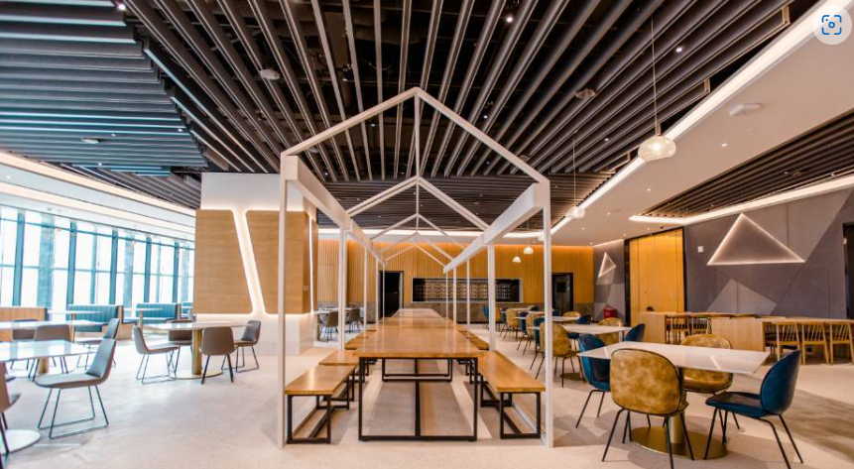

Thanks for listening !
Any questions?

